Slide 1

Refactoring
Code Smells
If it Stinks, change it!
65

Slide 2
What is Refactoring?
67

Slide 3

What is Refactoring?
A series of small steps, each of which changes the program’s internal structure without changing its external behavior - Martin Fowler
67

Slide 4
What is Refactoring?
A series of small steps, each of which changes the program’s internal structure without changing its external behavior - Martin Fowler
Verify no change in external behavior by
Testing
Using the right tool - IDE
Formal code analysis by tool
Being very, very careful
67

Slide 5
What if you hear...
68

Slide 6
What if you hear...
We’ll just refactor the code to support logging
68

Slide 7
What if you hear...
We’ll just refactor the code to support logging
68

Slide 8
What if you hear...
We’ll just refactor the code to support logging
Can you refactor the code so that it authenticates against LDAP instead of
Database?
68

Slide 9
What if you hear...
We’ll just refactor the code to support logging
Can you refactor the code so that it authenticates against LDAP instead of
Database?
68

Slide 10
What if you hear...
We’ll just refactor the code to support logging
Can you refactor the code so that it authenticates against LDAP instead of
Database?
We have too much duplicate code, we need to refactor the code to eliminate
duplication
68

Slide 11

What if you hear...
We’ll just refactor the code to support logging
Can you refactor the code so that it authenticates against LDAP instead of
Database?
We have too much duplicate code, we need to refactor the code to eliminate
duplication
68

Slide 12
What if you hear...
We’ll just refactor the code to support logging
Can you refactor the code so that it authenticates against LDAP instead of
Database?
We have too much duplicate code, we need to refactor the code to eliminate
duplication
This class is too big, we need to refactor it
68

Slide 13
What if you hear...
We’ll just refactor the code to support logging
Can you refactor the code so that it authenticates against LDAP instead of
Database?
We have too much duplicate code, we need to refactor the code to eliminate
duplication
This class is too big, we need to refactor it
68

Slide 14
What if you hear...
We’ll just refactor the code to support logging
Can you refactor the code so that it authenticates against LDAP instead of
Database?
We have too much duplicate code, we need to refactor the code to eliminate
duplication
This class is too big, we need to refactor it
Caching?
68

Slide 15
What if you hear...
We’ll just refactor the code to support logging
Can you refactor the code so that it authenticates against LDAP instead of
Database?
We have too much duplicate code, we need to refactor the code to eliminate
duplication
This class is too big, we need to refactor it
Caching?
68

Slide 16
Why do we Refactor?
70

Slide 17
Why do we Refactor?
Helps us deliver more business value faster
70

Slide 18
Why do we Refactor?
Helps us deliver more business value faster
Improves the design of our software
Combat’s “bit rot”
Easier to maintain and understand
Easier to facilitate change
More flexibility
Increased re-usability
70

Slide 19
Why do we Refactor?...
71

Slide 20
Why do we Refactor?...
Minimizes technical debt
71

Slide 21
Why do we Refactor?...
Minimizes technical debt
Keep development at speed
71

Slide 22
Why do we Refactor?...
Minimizes technical debt
Keep development at speed
To make the software easier to understand
Write for people, not the compiler
Understand unfamiliar code
71

Slide 23
Why do we Refactor?...
Minimizes technical debt
Keep development at speed
To make the software easier to understand
Write for people, not the compiler
Understand unfamiliar code
To help find bugs
refactor while debugging to clarify the code
71

Slide 24
Why do we Refactor?...
Minimizes technical debt
Keep development at speed
To make the software easier to understand
Write for people, not the compiler
Understand unfamiliar code
To help find bugs
refactor while debugging to clarify the code
To “Fix broken windows” - Pragmatic Programmers
71

Slide 25
Readability
Which code segment is easier to read?
Sample 1
if (date.Before(Summer_Start) || date.After(Summer_End)){
charge = quantity * winterRate + winterServiceCharge;
else charge = quantity * summerRate;
}
Sample 2
if (IsSummer(date)) {
charge = SummerCharge(quantity);
else charge = WinterCharge(quantity);
}
72

Slide 26
When should you refactor?
73

Slide 27
When should you refactor?
To add new functionality
refactor existing code until you understand it
refactor the design to make it simple to add
73

Slide 28
When should you refactor?
To add new functionality
refactor existing code until you understand it
refactor the design to make it simple to add
To find bugs
refactor to understand the code
73

Slide 29
When should you refactor?
To add new functionality
refactor existing code until you understand it
refactor the design to make it simple to add
To find bugs
refactor to understand the code
For code reviews
immediate effect of code review
allows for higher level suggestions
73

Slide 30
When should you refactor?
To add new functionality
refactor existing code until you understand it
Like championship
refactor the design to make it simple to add
To find bugs
snooker players we are
setting ourselves up for
refactor to understand the code
For code reviews
our next shot
immediate effect of code review
allows for higher level suggestions
73

Slide 31


The Two Hats
Adding Function
Refactoring
Add new capabilities to the
system
Adds new tests
Get the test working
Does not add any new features
Does not add tests (but may change some)
Restructure the code to remove
redundancy
74

Slide 32
How do we Refactor?
We look for Code-Smells
Things that we suspect are not quite right or will cause us severe pain if we do not fix
77

Slide 33
2 Piece of Advice before Refactoring
78

Slide 34

2 Piece of Advice before Refactoring
Baby Steps
78

Slide 35
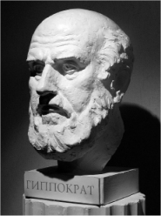
2 Piece of Advice before Refactoring
The Hippocratic Oath
First Do No Harm!
Baby Steps
78

Slide 36
Code Smells?
Code Smells identify frequently occurring design problems in a way that is more specific or targeted than general design guidelines (like “loosely coupled code” or “duplication-free code”). - Joshua K
A code smell is a design that duplicates, complicates, bloats or tightly couples code
79

Slide 37

A short history of Code Smells
If it stinks, change it!
Kent Beck coined the term code smell to signify
something in code that needed to be changed.
80

Slide 38

Common Code Smells
Inappropriate Naming
Comments
Dead Code
Duplicated code
Primitive Obsession
Large Class
Lazy Class
Alternative Class with
Different Interface
Long Method
Long Parameter List
Switch Statements
Speculative Generality
Oddball Solution
Feature Envy
Refused Bequest
Black Sheep
Train Wreck
81

Slide 39
Inappropriate Naming
82

Slide 40

Inappropriate Naming
Names given to variables (fields) and methods should be clear and meaningful.
82

Slide 41
Inappropriate Naming
Names given to variables (fields) and methods should be clear and meaningful.
A variable name should say exactly what it is.
Which is better?
private string s; OR private string salary;
82

Slide 42
Inappropriate Naming
Names given to variables (fields) and methods should be clear and meaningful.
A variable name should say exactly what it is.
Which is better?
private string s; OR private string salary;
A method should say exactly what it does.
Which is better?
public double calc (double s)
public double calculateFederalTaxes (double salary)
82

Slide 43
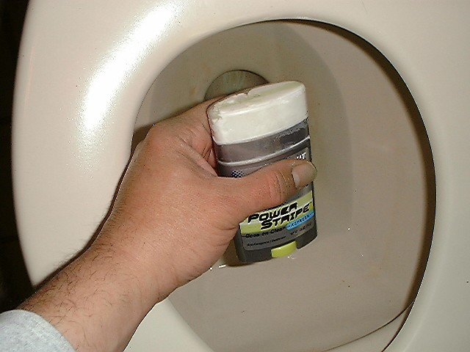
Comments
Comments are often used as deodorant
Comments represent a failure to express an idea in the code. Try to make your code self-documenting or intention-revealing
When you feel like writing a comment, first try "to refactor so that the
comment becomes superfluous.
Remedies:
Extract Method
Rename Method
Introduce Assertion
83

Slide 44
Comment: “Grow the Array” smells
public class MyList
{
int INITIAL_CAPACITY = 10;
bool m_readOnly;
int m_size = 0;
int m_capacity;
string[] m_elements;
public MyList()
{
m_elements = new string[INITIAL_CAPACITY];
m_capacity = INITIAL_CAPACITY;
}
int GetCapacity() {
return m_capacity;
}
}
void AddToList(string element)
{
if (!m_readOnly)
{
int newSize = m_size + 1;
if (newSize > GetCapacity())
{
// grow the array
m_capacity += INITIAL_CAPACITY;
string[] elements2 = new string[m_capacity];
for (int i = 0; i < m_size; i++)
elements2[i] = m_elements[i];
m_elements = elements2;
}
m_elements[m_size++] = element;
}
}
84

Slide 45
Comment Smells Make-over
void AddToList(string element)
{
if (m_readOnly)
return;
if (ShouldGrow())
{
Grow();
}
StoreElement(element);
}
private void Grow()
{
m_capacity += INITIAL_CAPACITY;
string[] elements2 = new string[m_capacity];
for (int i = 0; i < m_size; i++)
elements2[i] = m_elements[i];
m_elements = elements2;
}
private void StoreElement(string element)
{
m_elements[m_size++] = element;
}
private bool ShouldGrow()
{
return (m_size + 1) > GetCapacity();
}
85

Slide 46

Smell: Comments
Rename Method
86

Slide 47
Smell: Comments
Extract Method
87

Slide 48
Smell: Comments
Extract Method
void PrintOwning(double amount){
PrintBanner();
// print details
System.Console.Out.WriteLine(“name: “+ name);
System.Console.Out.WriteLine(“amount: “+ amount);
}
87

Slide 49
Smell: Comments
Extract Method
void PrintOwning(double amount){
PrintBanner();
// print details
System.Console.Out.WriteLine(“name: “+ name);
System.Console.Out.WriteLine(“amount: “+ amount);
}
void PrintOwning(double amount){
PrintBanner();
PrintDetails(amount);
}
void PrintDetails(double amount){
System.Console.Out.WriteLine(“name: “+ name);
System.Console.Out.WriteLine(“amount: “+ amount);
}
87

Slide 50
Smell: Comments
Introduce Assertion
88

Slide 51
Smell: Comments
Introduce Assertion
double getExpenseLimit() {
// should have either expense limit or a primary project return (_expenseLimit != NULL_EXPENSE) ? _expenseLimit : _primaryProject.GetMemberExpenseLimit();
}
88

Slide 52

Smell: Comments
Introduce Assertion
double getExpenseLimit() {
// should have either expense limit or a primary project return (_expenseLimit != NULL_EXPENSE) ? _expenseLimit : _primaryProject.GetMemberExpenseLimit();
}
double getExpenseLimit() {
Assert(_expenseLimit != NULL_EXPENSE || _primaryProject != null, “Both Expense Limit and Primary Project must not be null”);
return (_expenseLimit != NULL_EXPENSE) ? _expenseLimit :
_primaryProject.GetMemberExpenseLimit();
}
88

Slide 53
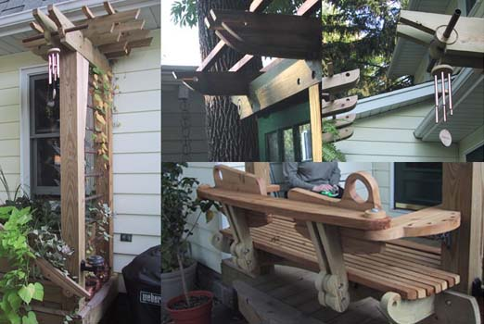
Long Method
89

Slide 54
Long Method
A method is long when it is too hard to quickly comprehend.
89

Slide 55
Long Method
A method is long when it is too hard to quickly comprehend.
Long methods tend to hide behavior that ought to be shared, which leads to duplicated code in other methods or classes.
89

Slide 56
Long Method
A method is long when it is too hard to quickly comprehend.
Long methods tend to hide behavior that ought to be shared, which leads to duplicated code in other methods or classes.
Good OO code is easiest to understand and maintain with shorter methods
with good names
89

Slide 57
Long Method
A method is long when it is too hard to quickly comprehend.
Long methods tend to hide behavior that ought to be shared, which leads to duplicated code in other methods or classes.
Good OO code is easiest to understand and maintain with shorter methods
with good names
Remedies:
Extract Method
Replace Temp with Query
Introduce Parameter Object
Preserve Whole Object
Replace Method with Method Object.
Decompose Conditional
89

Slide 58
Long Method Example
private String toStringHelper(StringBuffer result)
{
result.append("<");
result.append(name);
result.append(attributes.toString());
result.append(">");
if (!value.equals(""))
result.append(value);
Iterator it = children().iterator();
while (it.hasNext())
{
TagNode node = (TagNode)it.next();
node.toStringHelper(result);
}
result.append("</");
result.append(name);
result.append(">");
return result.toString();
}
90

Slide 59
Long Method Makeover (Extract Method)
private String toStringHelper(StringBuffer result)
{
writeOpenTagTo(result);
writeValueTo(result);
writeChildrenTo(result);
writeEndTagTo(result);
return result.toString();
}
private void writeOpenTagTo(StringBuffer result)
{
result.append("<");
result.append(name);
result.append(attributes.toString());
result.append(">");
}
private void writeEndTagTo(StringBuffer result)
{
result.append("</");
result.append(name);
result.append(">");
}
private void writeValueTo(StringBuffer result)
{
if (!value.equals(""))
result.append(value);
}
private void writeChildrenTo(StringBuffer result)
{
Iterator it = children().iterator();
while (it.hasNext())
{
TagNode node = (TagNode)it.next();
node.toStringHelper(result);
}
}
91

Slide 60
Smell: Long Method
Replace Temp with Query
double basePrice = _quanity * _itemPrice;
if(basePrice > 1000) {
return basePrice * 0.95;
}
else {
return basePrice * 0.98;
}
92

Slide 61

Smell: Long Method
Replace Temp with Query
if(getBasePrice() > 1000) {
return getBasePrice() * 0.95;
}
else {
return getBasePrice() * 0.98;
}
double getBasePrice() {
return _quanitiy * itemPrice;
}
double basePrice = _quanity * _itemPrice; if(basePrice > 1000) {
return basePrice * 0.95;
}
else {
return basePrice * 0.98;
}
92

Slide 62
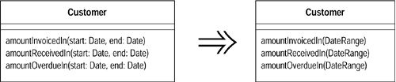
Smell: Long Method
Introduce Parameter Object
94

Slide 63
Smell: Long Method
Preserve Whole Object
int low = daysTempRange().getLow();
int high = daysTempRange().getHigh();
withinPlan = plan.withinRange(low, high);
95

Slide 64
Smell: Long Method
Preserve Whole Object
int low = daysTempRange().getLow();
int high = daysTempRange().getHigh();
withinPlan = plan.withinRange(low, high);
withinPlan = plan.withinRange(daysTempRange());
95

Slide 65
Smell: Long Method
Replace Method with Method Object
//class Order...
double price() {
double primaryBasePrice;
double secondaryBasePrice;
double tertiaryBasePrice;
// long computation;
...
}
96

Slide 66
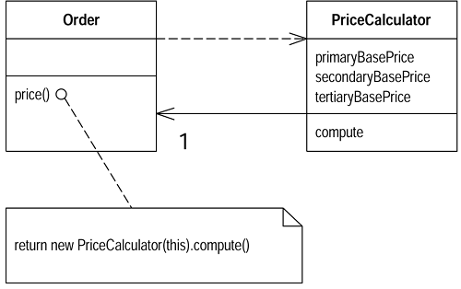
Smell: Long Method
Replace Method with Method Object
//class Order...
double price() {
double primaryBasePrice;
double secondaryBasePrice;
double tertiaryBasePrice;
// long computation;
...
}
96

Slide 67

Smell: Long Method
Decompose Conditional
You have a complicated conditional (if-then-else) statement.
Extract methods from the condition, then part, and else parts.
if (date.before (SUMMER_START) || date.after(SUMMER_END))
charge = quantity * _winterRate + _winterServiceCharge;
else charge = quantity * _summerRate;
if (notSummer(date))
charge = winterCharge(quantity);
else charge = summerCharge (quantity);
97

Slide 68
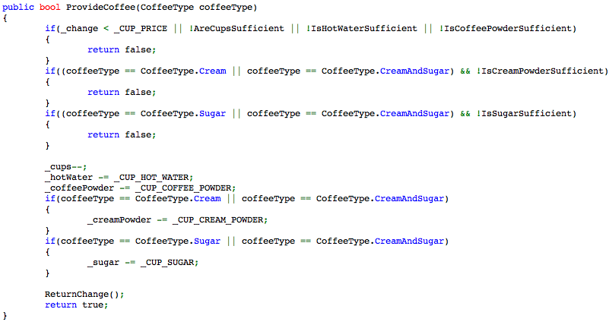
Example of Conditional Complexity
98

Slide 69
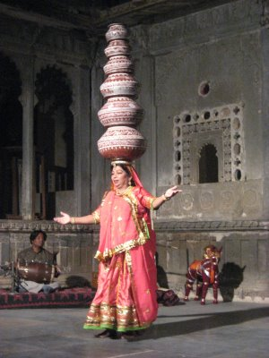
Long Parameter List
Methods that take too many parameters produce client code that is awkward and difficult to work with.
Remedies:
Introduce Parameter Object
Replace Parameter with Method
Preserve Whole Object
174

Slide 70
Example
private void createUserInGroup() {
GroupManager groupManager = new GroupManager();
Group group = groupManager.create(TEST_GROUP, false, GroupProfile.UNLIMITED_LICENSES, "",
GroupProfile.ONE_YEAR, null);
user = userManager.create(USER_NAME, group, USER_NAME, "jack", USER_NAME, LANGUAGE, false, false, new Date(),
"blah", new Date());
}
175

Slide 71
Smell: Long Parameter List
Introduce Parameter Object
176

Slide 72
Smell: Long Parameter List
Introduce Parameter Object
Customer
AmoutInvoicedIn(Date start, Date end)
AmoutRecivedIn(Date start, Date end)
AmoutOverdueIn(Date start, Date end)
176

Slide 73

Smell: Long Parameter List
Introduce Parameter Object
Customer
AmoutInvoicedIn(Date start, Date end)
AmoutRecivedIn(Date start, Date end)
AmoutOverdueIn(Date start, Date end)
Customer
AmoutInvoicedIn(DateRange range)
AmoutRecivedIn(DateRange range)
AmoutOverdueIn(DateRange range)
176

Slide 74
Smell: Long Parameter List
Replace Parameter with Method
public double getPrice() {
int basePrice = _quantity * _itemPrice;
int discountLevel;
if (_quantity > 100)
discountLevel = 2;
else
discountLevel = 1;
double finalPrice = discountedPrice (basePrice, discountLevel);
return finalPrice;
}
private double discountedPrice (int basePrice, int discountLevel) {
if (discountLevel == 2)
return basePrice * 0.1;
else
return basePrice * 0.05;
}
177

Slide 75
Smell: Long Parameter List
Replace Parameter with Method
public double getPrice() {
int basePrice = _quantity * _itemPrice;
int discountLevel = getDiscountLevel();
double finalPrice = discountedPrice (basePrice, discountLevel);
return finalPrice;
}
private int getDiscountLevel() {
if (_quantity > 100) return 2;
else return 1;
}
private double discountedPrice (int basePrice, int discountLevel) {
if (getDiscountLevel() == 2) return basePrice * 0.1;
else return basePrice * 0.05;
}
177

Slide 76
Smell: Long Parameter List
Replace Parameter with Method
public double getPrice() {
int basePrice = _quantity * _itemPrice;
int discountLevel = getDiscountLevel();
double finalPrice = discountedPrice (basePrice);
return finalPrice;
}
private double discountedPrice (int basePrice) {
if (getDiscountLevel() == 2) return basePrice * 0.1;
else return basePrice * 0.05;
}
177

Slide 77
Smell: Long Parameter List
Preserve Whole Object
int low = daysTempRange().getLow();
int high = daysTempRange().getHigh();
withinPlan = plan.withinRange(low, high);

Slide 78
Smell: Long Parameter List
Preserve Whole Object
int low = daysTempRange().getLow();
int high = daysTempRange().getHigh();
withinPlan = plan.withinRange(low, high);
withinPlan = plan.withinRange(daysTempRange());

Slide 79

Feature Envy
A method that seems more interested in some other class than the one it is in.
Data and behavior that acts on that data belong together. When a method
makes too many calls to other classes to obtain data or functionality, Feature
Envy is in the air.
Remedies:
Move Field
Move Method
Extract Method
178

Slide 80
Example
Public class CapitalStrategy{
double capital(Loan loan)
{
if (loan.getExpiry() == NO_DATE && loan.getMaturity() != NO_DATE)
return loan.getCommitmentAmount() * loan.duration() * loan.riskFactor();
if (loan.getExpiry() != NO_DATE && loan.getMaturity() == NO_DATE)
{
if (loan.getUnusedPercentage() != 1.0)
return loan.getCommitmentAmount() * loan.getUnusedPercentage() * loan.duration() * loan.riskFactor();
else
return (loan.outstandingRiskAmount() * loan.duration() * loan.riskFactor()) +
(loan.unusedRiskAmount() * loan.duration() * loan.unusedRiskFactor());
}
return 0.0;
}
}
179

Slide 81
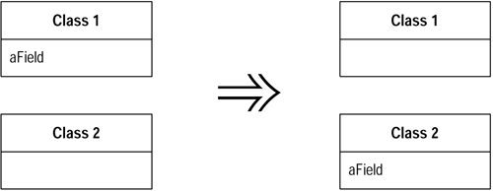
Smell: Feature Envy
Move Field
180

Slide 82
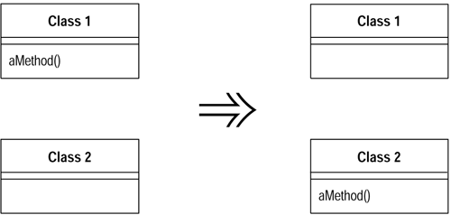
Smell: Feature Envy
Move Method
181

Slide 83
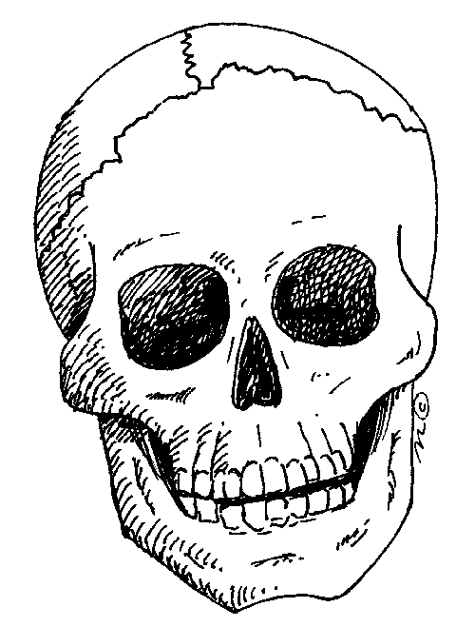

Dead Code
Code that is no longer used in a system or related system is Dead Code.
Increased Complexity.
Accidental Changes.
More Dead Code
Remedies
114

Slide 84
Dead Code Example
A Loan class contains five constructors, three of which are shown below:
public class Loan…
public Loan(double commitment, int riskRating, Date maturity, Date expiry) { this(commitment, 0.00, riskRating, maturity, expiry); }
public Loan(double commitment, double outstanding, int customerRating, Date maturity, Date expiry) { this(null, commitment, outstanding, customerRating, maturity, expiry); }
public Loan(CapitalStrategy capitalStrategy, double commitment, int riskRating, Date maturity, Date expiry) { this(capitalStrategy, commitment, 0.00, riskRating, maturity, expiry); } ... }
One of the above constructors is never called by a client. It is dead code.
115

Slide 85
Duplicated Code
The most pervasive and pungent smell in software
There is obvious or blatant duplication
Such as copy and paste
There are subtle or non-obvious duplications
Such as parallel inheritance hierarchies.
Similar algorithms
Remedies
Extract Method
Pull Up Field
Form Template Method
Substitute Algorithm
122

Slide 86
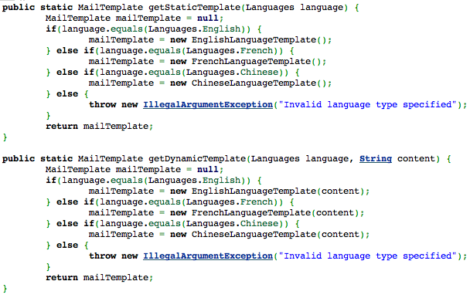
Ctl+C Ctl+V Pattern
123

Slide 87
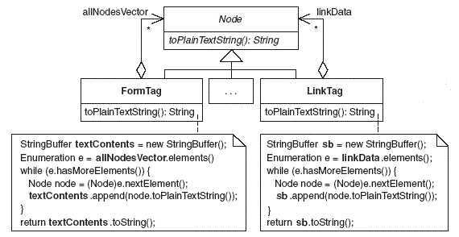
Example Of Obvious Duplication
124

Slide 88
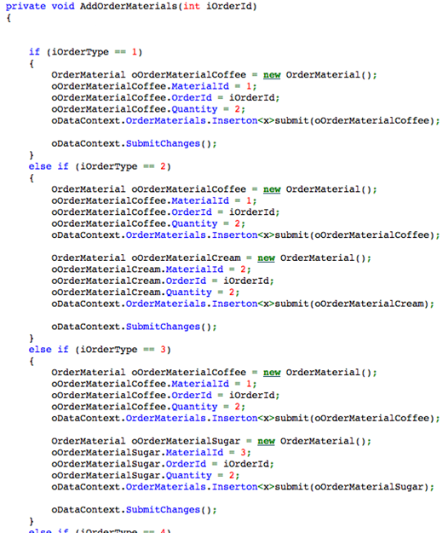
126

Slide 89
Levels of Duplication
127

Slide 90
Literal Duplication
Same for loop in 2 places
128

Slide 91
Semantic Duplication
1stLevel - For and For Each Loop
2ndLevel - Loop v/s Lines repeated
stack.push(1); stack.push(3); stack.push(5); stack.push(10); stack.push(15);
v/s
for(int i : asList(1,3,5,10,15)) stack.push(i);
129

Slide 92
Data Duplication
Some constant declared in 2 classes (test and production)
130

Slide 93
Conceptual Duplication
2 Algorithm to Sort elements (Bubble sort and Quick sort)
132

Slide 94
Logical Steps - Duplication
Same set of steps repeat in different scenarios.
Ex: Same set of validations in various points in your applications
134

Slide 95
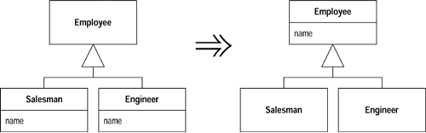
Smell: Duplicate Code
Pull Up Field
136

Slide 96
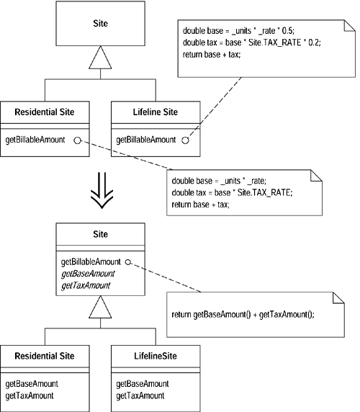
Smell: Duplicate Code
Form Template Method
137

Slide 97
Smell: Duplicate Code
Substitute Algorithm
138

Slide 98
Smell: Duplicate Code
Substitute Algorithm
String foundPerson(String[] people){
for (int i = 0; i < people.length; i++) {
if (people[i].equals ("Don")){
return "Don";
}
if (people[i].equals ("John")){
return "John";
}
if (people[i].equals ("Kent")){
return "Kent";
}
}
return ""; }
138

Slide 99
Smell: Duplicate Code
Substitute Algorithm
String foundPerson(String[] people){
for (int i = 0; i < people.length; i++) {
if (people[i].equals ("Don")){
return "Don";
}
if (people[i].equals ("John")){
return "John";
}
if (people[i].equals ("Kent")){
return "Kent";
}
}
return "";
}
String foundPerson(String[] people){
List candidates = Arrays.asList(new String[] {"Don", "John", "Kent"});
for (String person : people)
if (candidates.contains(person))
return person;
return "";
}
138

Slide 100

Speculative Generality
You get this smell when people say "Oh, I think we will need the ability to do that someday" and thus want all sorts of hooks and special cases to handle things that aren't required.
This odor exists when you have generic or abstract code that isn’t actually
needed today. Such code often exists to support future behavior, which may or may not be necessary in the future.
Remedies
Collapse Hierarchy
Inline Class
Remove Parameter
105

Slide 101
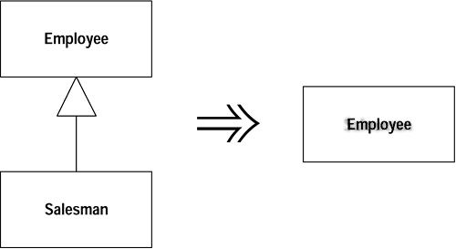
Smell: Speculative Generality
Collapse Hierarchy
Salesman
104

Slide 102
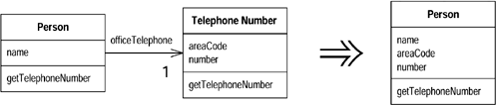
Smell: Speculative Generality
Inline Class
109

Slide 103

Smell: Speculative Generality
Remove Parameter
110

Slide 104
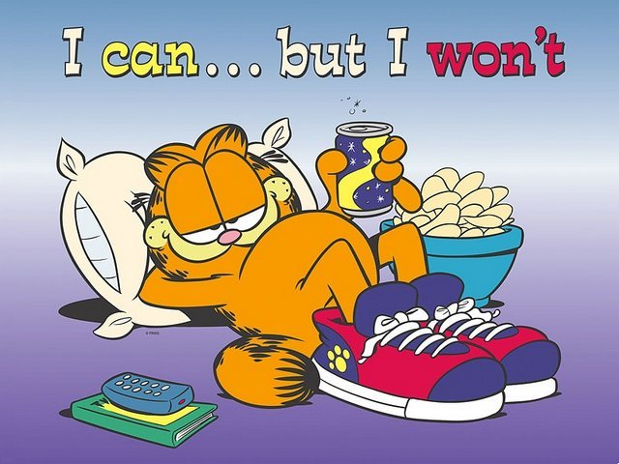
Lazy Class
A class that isn't doing enough to carry its weight
We let the class die with dignity
Often this might be a class that used to pay its way but has been downsized with refactoring. Or it might be a class that was added because of changes that were planned but not made.
Remedies
Inline Class
Collapse Hierarchy
99

Slide 105
Lazy Clazz Example
public interface SomeInterface {
void methodOne();
void defaultMethod();
}
public abstract class LazyClazz implements SomeInterface {
public abstract void methodOne();
public void defaultMethod() {
//do nothing
}
}
public class WorkerClazz extends LazyClazz {
public void methodOne() {
// some actual code here
}
public void defaultMethod() {
//some more actual code
}
}
100

Slide 106
Another Lazy Class
public class Letter {
private final String content;
public Letter(String content) {
this.content = content;
}
public String getContent() {
return content;
}
}
102

Slide 107
Smell: Lazy Class
Inline Class
103

Slide 108
Smell: Lazy Class
Collapse Hierarchy
Salesman
104

Slide 109

Refused Bequest
This rather potent odor results when subclasses inherit code that they don’t want. In some cases, a subclass may “refuse the bequest” by providing a do-nothing implementation of an inherited method.
Remedies
Push Down Field
Push Down Method
116

Slide 110
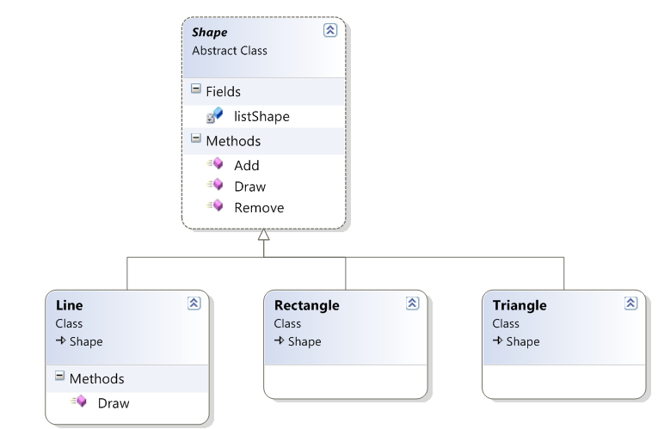
Smell: Refused Bequest
Example of Refused Bequest
Salesman
104

Slide 111
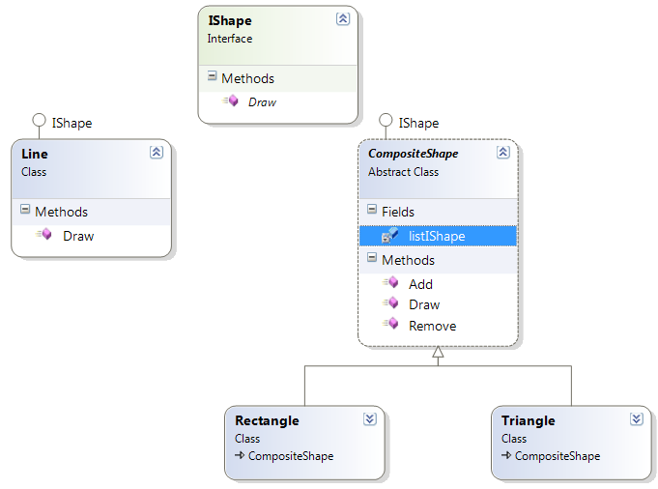
Smell: Refused Bequest
Refused Bequest Make Over
104

Slide 112
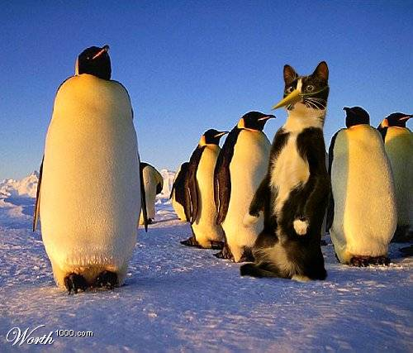
Black Sheep
Sometimes a subclass or method doesn't fit in so well with its family.
A subclass that is substantially different in nature than other subclasses in the hierarchy.
A method in a class that is noticeably different from other methods in the class.
118

Slide 113
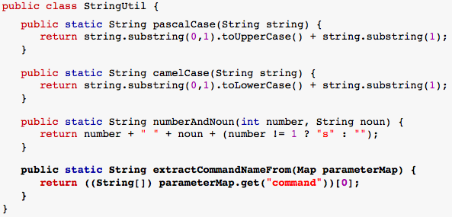
Example
119

Slide 114
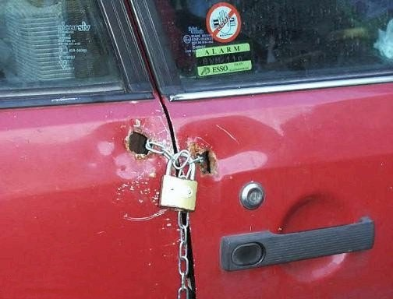
Primitive Obsession
This smell exists when primitives, such as strings, doubles, arrays or low-level language components, are used for high-level operations instead of using classes.
This typically occurs when you haven’t yet seen how a higher-level
abstraction can clarify or simplify your code.
Remedies
Extract Class
Replace Data Value with Object
Replace Type Code with Class
Introduce Parameter Object
Replace Array with Object
160

Slide 115

Primitive Obsession Example
if (someString.indexOf("substring") != -1)
if(someString.contains("substring"))
161

Slide 116
Primitive Obsession Example
private void Grow() {
Object[] newElements = new Object[elements.length + 10];
for (int i = 0; i < size; i++)
newElements[i] = elements[i];
elements = newElements;
}
private void Grow() {
Object[] newElements = new Object[elements.length + INITIAL_CAPACITY];
System.arraycopy(elements, 0, newElements, 0, size);
elements = newElements;
}
161

Slide 117
Primitive Obsession Example
public class CompositeShape
{
IShape [] arr = new IShape[100];
int count = 0;
public void Add(IShape shape){
arr[count++] = shape;
}
public void Remove(IShape shape)
{
for (int i = 0; i < 100; i++)
{
if (shape == arr[i])
{
//code to remove
}
}
}
}
161

Slide 118
Primitive Obsessed Code - Make Over
public class CompositeShape
{
List<IShape> shapeList = new List<IShape>();
public void Add(IShape shape)
{
shapeList.Add(shape);
}
public void Remove(IShape shape)
{
shapeList.Remove(shape);
}
}
163

Slide 119
Smell: Primitive Obsession
Replace Array with Object
String[] row = new String[3];
row [0] = "Liverpool";
row [1] = "15";
167

Slide 120
Smell: Primitive Obsession
Replace Array with Object
String[] row = new String[2];
row [0] = "Liverpool";
row [1] = "15";
Performance row = new Performance("Liverpool", "15");
167

Slide 121
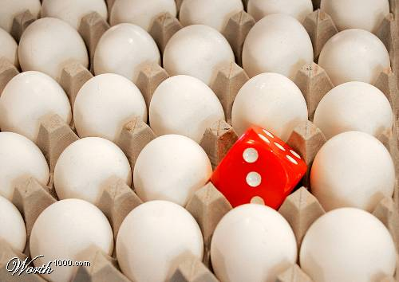
Oddball Solution
When a problem is solved one way throughout a system and the same problem is solved another way in the same system, one of the solutions is the oddball or inconsistent solution. The presence of this smell usually indicates subtly duplicated code.
168

Slide 122
Oddball Solution Example
string LoadUserProfileAction::process()
{
//some code here
return process("ViewAction");
}
string UploadAction::process() {
//some code here
return process("ViewAction");
}
string ShowLoginAction::process() {
//some other code here
Action* viewAction = actionProcessor().get("ViewAction");
return viewAction->process();
}
169

Slide 123
Oddball Solution Example
private void grow() {
Object[] newElements = new Object[elements.length + 10];
for (int i = 0; i < size; i++)
newElements[i] = elements[i];
elements = newElements;
}
private void anotherGrow() {
Object[] newElements = new Object[elements.length + INITIAL_CAPACITY];
System.arraycopy(elements, 0, newElements, 0, size);
elements = newElements;
}
170

Slide 124
Smell: Odd Ball Solution
Substitute Algorithm
String foundPerson(String[] people){
for (int i = 0; i < people.length; i++) {
if (people[i].equals ("Don")){
return "Don";
}
if ("John".equals (people[i])){
return "John";
}
if (people[i].equals ("Kent")){
return "Kent";
}
}
return ""; }
171

Slide 125
Smell: Odd Ball Solution
Substitute Algorithm
String foundPerson(String[] people){
for (int i = 0; i < people.length; i++) {
if (people[i].equals ("Don")){
return "Don";
}
if ("John".equals (people[i])){
return "John";
}
if (people[i].equals ("Kent")){
return "Kent";
}
}
return ""; }
String foundPerson(String[] people){ List candidates = Arrays.asList(new String[] {"Don", "John", "Kent"});
for (String person : people)
if (candidates.contains(person))
return person;
return ""; }
171

Slide 126
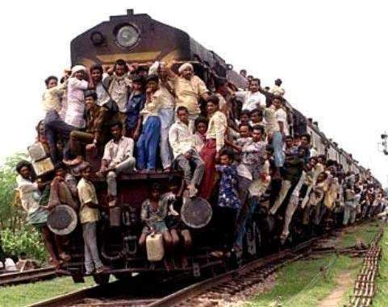
Large Class
Like people, classes suffer when they take on too many responsibilities.
GOD Objects
Fowler and Beck note that the presence of too many instance variables usually indicates that a class is trying to do too much. In general, large classes typically contain too many responsibilities.
Remedies
Extract Class
Replace Type Code with Class/Subclass
Replace Type Code with State/Strategy
Replace Conditional with Polymorphism
152

Slide 127
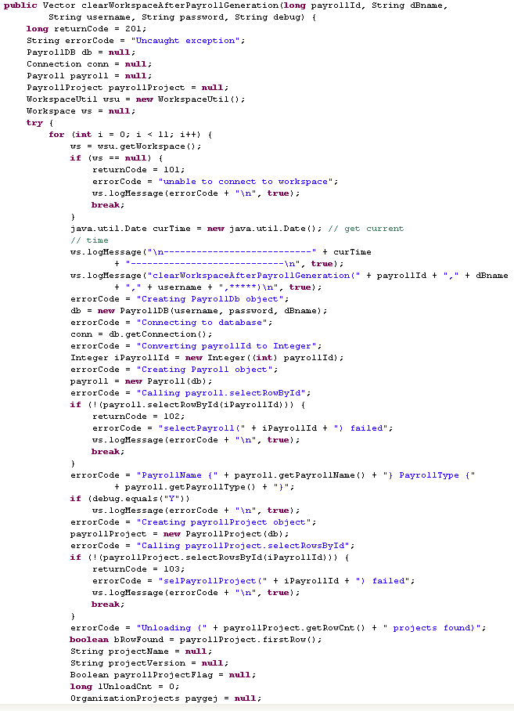
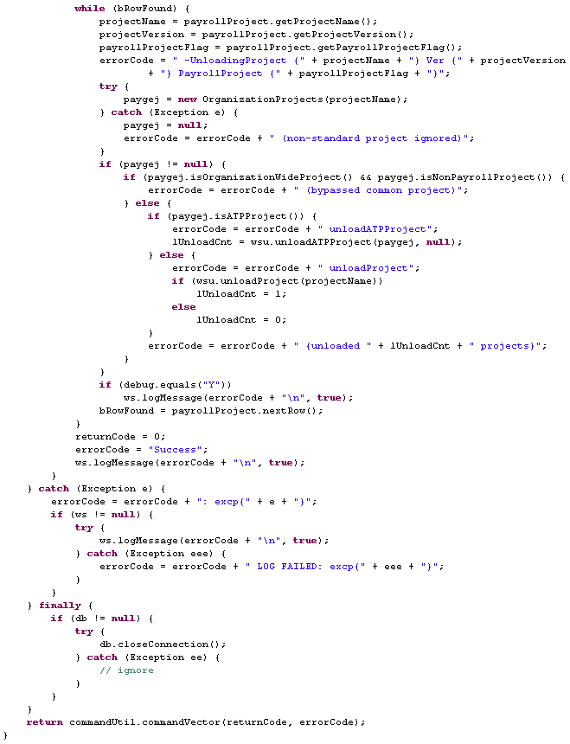
153
153

Slide 128
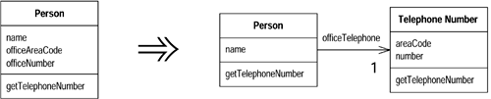
Smell: Large Class
Extract Class
154

Slide 129
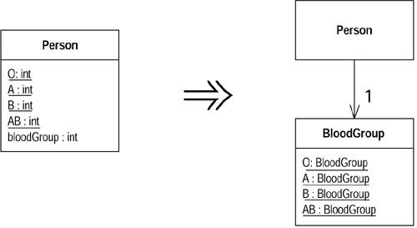
Smell: Large Class
Replace Type Code with Class
155

Slide 130
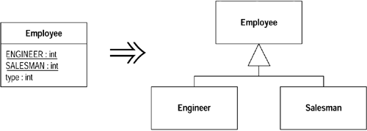
Smell: Large Class
Replace Type Code with Subclasses
156

Slide 131
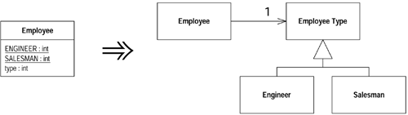
Smell: Large Class
Replace Type Code with State/Strategy
157

Slide 132
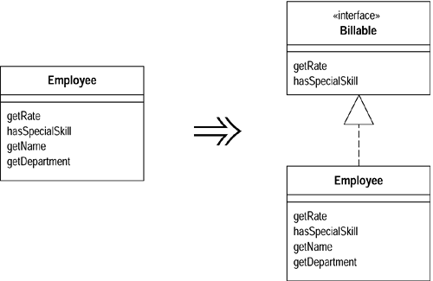
Smell: Large Class
Extract (Narrow) Interface
158

Slide 133
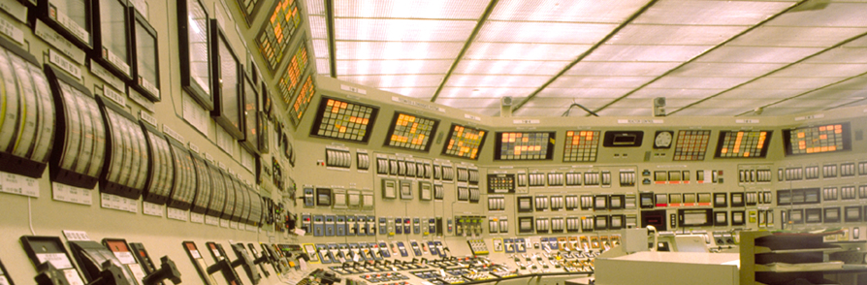
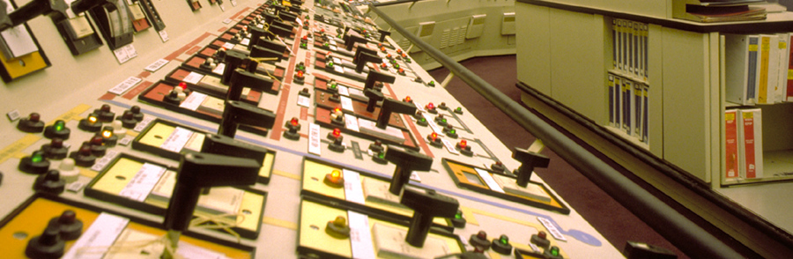
Switch Statement
This smell exists when the same switch statement (or “if…else if…else if” statement) is duplicated across a system.
Such duplicated code reveals a lack of object-orientation and a missed
opportunity to rely on the elegance of polymorphism.
Remedies:
Replace Type Code with Polymorphism
Replace Type Code with State / Strategy
Replace Parameter with Explicit Methods
Introduce Null Object.
139

Slide 134
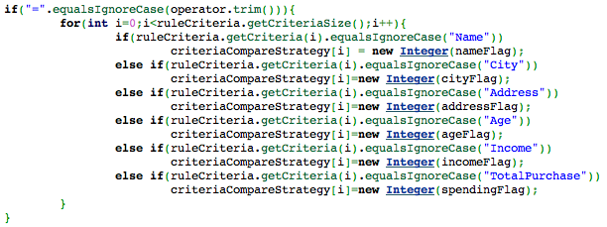
Switch Smell Examples
140

Slide 135
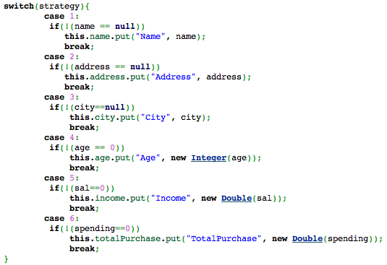
More Switch Smell Examples
142

Slide 136
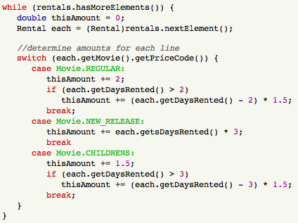
Evil Switch Example
143

Slide 137
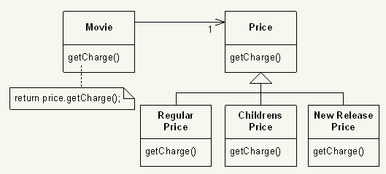
Smell: Switch Smell
Replace Type Code with Polymorphism
144

Slide 138
Smell: Switch Smell
Replace Parameter with Method
void setValue (String name, int value) {
if (name.equals("height"))
this.height = value;
else if (name.equals("width"))
this.width = value;
}
145

Slide 139
Smell: Switch Smell
Replace Parameter with Method
void setValue (String name, int value) {
if (name.equals("height"))
this.height = value;
else if (name.equals("width"))
this.width = value;
}
void setHeight(int h) { this.height = h;
}
void setWidth (int w) { this.width = w;
}
145

Slide 140
Smell: Switch Smell
Introduce Null Object
// In client class
Customer customer = site.getCustomer();
BillingPlan plan;
if (customer == null)
plan = BillingPlan.basic();
else
plan = customer.getPlan();
146

Slide 141
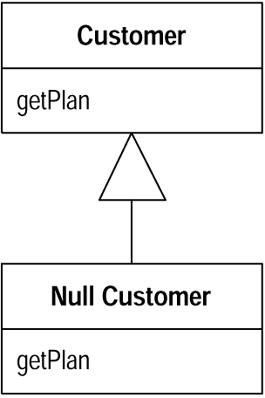
Smell: Switch Smell
Introduce Null Object
// In client class
Customer customer = site.getCustomer();
BillingPlan plan;
if (customer == null) plan = BillingPlan.basic();
else plan = customer.getPlan();
// In client class
Customer customer = site.getCustomer();
BillingPlan plan = customer.getPlan();
// In Null Customer
public BillingPlan getPlan(){
return BillingPlan.basic();
}
146

Slide 142
Refactoring & Patterns
There is a natural relation between patterns and refactorings. Patterns are where you want to be; refactorings are ways to get there from somewhere else. - Martin Fowler
182

Slide 143


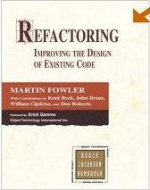
Reference Reading
185

Slide 144
Further Information On
Code Smells and Refactoring
Wiki Discussion About Code Smells: http://c2.com/cgi/wiki?CodeSmell
Mika’s Smell Taxonomy: http://www.soberit.hut.fi/mmantyla/
BadCodeSmellsTaxonomy.htm
Bill Wake’s book, “Refactoring Workbook”
Refactoring Catalog Online: http://www.refactoring.com/catalog/index.html
Refactoring to Patterns Catalog Online: http://industriallogic.com/xp/ refactoring/catalog.html
186

Slide 145
References
[F] Fowler, Martin. Refactoring: Improving the Design of Existing Code.
Boston, MA: Addison-Wesley, 2000
[K] Kerievsky, Joshua. Refactoring to Patterns. Boston, MA: Addison-Wesley,
2005
187

